Slide 1
Streaming Covid-19 Sentiments
MACS 30123 Final Project
Caton Brewster, Gabriela Palacios, Antonia Sanhueza

Slide 2
Social Problem
Provide policymakers with a tool to track public sentiment around Covid-19 based on Twitter data
Policymakers can use to inform policy-making
Tool can be adapted to track sentiments around a number of topics

Slide 3

Social Problem: Project Scope
Focus: compare sentiments over time in Mexico City (liberal) and Guadalajara (conservative).

Slide 4
2. Project Outline
Scrape Twitter data using twint
Run Kinesis Stream on EC2 instances
Sentiment Analysis with lambda function
Visualize sentiments with PySpark

Slide 5
Scraping Twitter Data
Scrape Twitter data using twint
Twitter API Restrictions
Simulate stream
Data Details
Mexico City and Guadalajara
November 30th - December 10th, 2021
Search terms: "covid", "covid-19", "covid19", "coronavirus"
20 daily tweets

Slide 6
2. Project Outline
Scrape Twitter data using twint
Run Kinesis Stream on EC2 instances

Slide 7
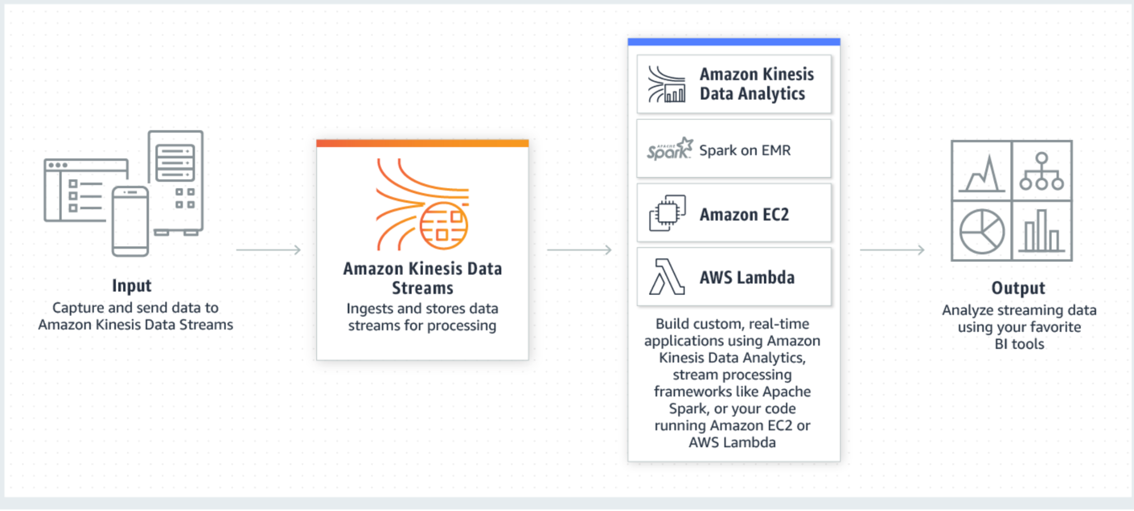
Kinesis Stream
Notes:
We create a kinesis stream and run our producer and consumer files on EC2 instances. Our producer pulls each object (tweet) from our s3 bucket of stored tweets and sends them into the kinesis stream. The consumer pulls the tweets from the stream, calls the lambda function to run sentiment analysis on each tweet, and stores the clean, analyzed tweets in an s3 bucket.

Slide 8
2. Project Outline
Scrape Twitter data using twint
Run Kinesis Stream on EC2 instances
Sentiment Analysis with lambda function

Slide 9
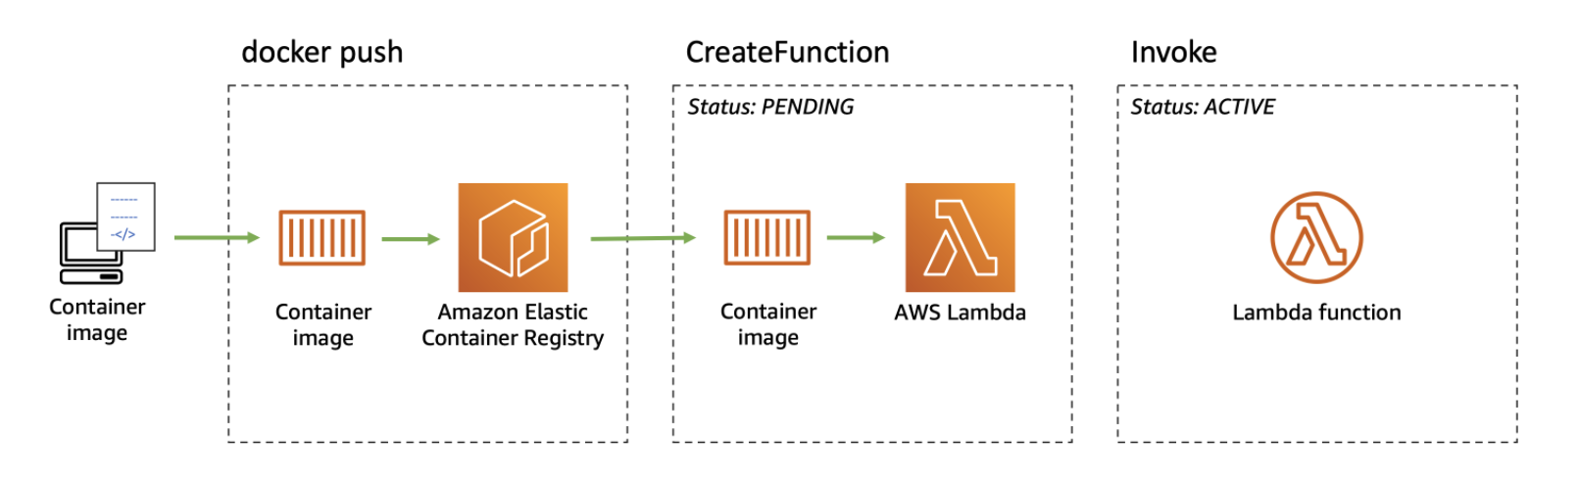
Lambda
Notes:
We set up a lambda function as a public url through a docker image, using AWS Elastic Container Registry. The model for sentiment analysis used in the lambda function is from the Huggingface library, which is an NLP sentiment analysis model trained on twitter data in Spanish, which is required for the location chosen. However, this could be updated to process any language, as needed.

Slide 10
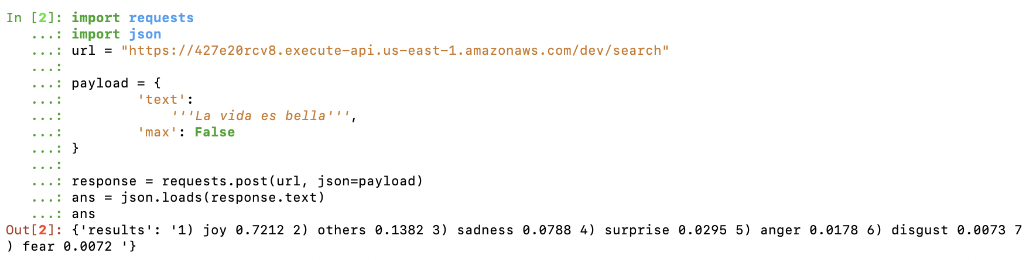
Lambda
Notes:
This is how the lambda function would look like on one tweet, we can see how the output represent the prevalence of these 7 types of emotions in one tweet

Slide 11
2. Project Outline
Scrape Twitter data using twint
Run Kinesis Stream on EC2 instances
Sentiment Analysis with lambda function
Visualize Sentiments with PySpark

Slide 12
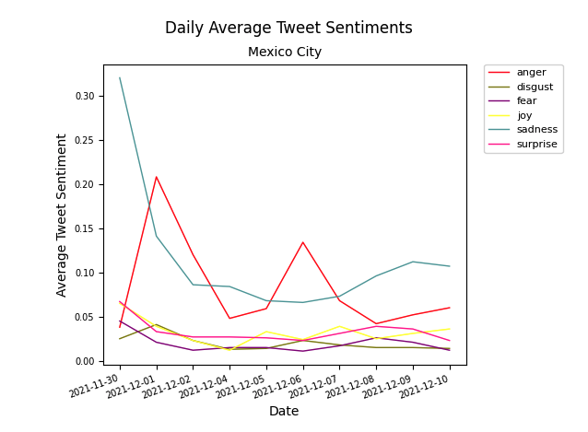
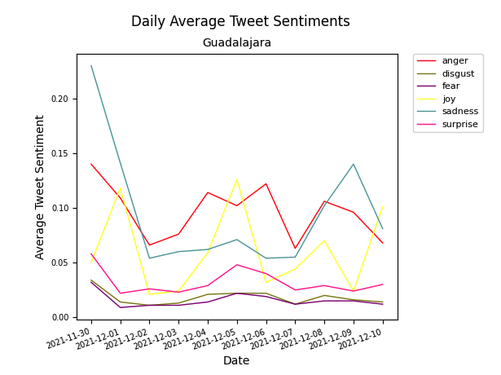
Visualizing the Data
Notes:
NOTE THE SCALE!

Slide 13
Conclusion
Tool to track sentiments towards Covid-19
Tool is scalable and adaptable
can change tweets’ date range, search words, and location
can apply any NLP model through the ECR - lambda method
AWS Resources used are cost effective
affordable at scale
charged in proportion to use

